Slide 1

Project Title - Seasonal Agriculture Performance Analysis
Student Name: Peraka Sai Priya
College Name: Malla Reddy Institute of Engineering and Technology
AICTE STU ID: STU672e197053d5d1731074416

Slide 2

PROBLEM STATEMENT
Agricultural performance is influenced by seasonal variations in environmental conditions, farming practices, resource availability and market conditions.
The project analyzes the given agricultural dataset to identify seasonal differences, meaningful patterns, trends, relationships and variations in agricultural performance.
The analysis focuses on yield, production, resource usage, environmental conditions, profitability, water efficiency and disease/pest risk.

Slide 3
Project Description
Seasonal Agriculture Performance Analysis
Dataset size: 4,000 records × 28 variables.
Data covers farms, locations, crops and Kharif, Rabi and Zaid seasons.
Data preparation included missing-value and duplicate checks and categorical cleaning.
Exploratory analysis compared yield, production, profit, rainfall, soil/resource usage, water efficiency and disease/pest risk.
Correlation analysis and one-way ANOVA were used to investigate relationships and seasonal differences.

Slide 4

WHO ARE THE END USERS?
Farmers – understand seasonal productivity and resource requirements.
Agricultural planners – support evidence-based seasonal planning.
Agricultural researchers – identify patterns and areas for further study.
Policy makers – understand regional and seasonal agricultural performance.
Data analysts – use the dataset for further agricultural analytics.

Slide 5

Technology Used
Google Colab / Jupyter Notebook
Python
Pandas – data loading, cleaning and aggregation
NumPy – numerical operations
Matplotlib & Seaborn – data visualization
SciPy – statistical testing (ANOVA)
CSV dataset – Seasonal Agriculture Performance Dataset

Slide 6
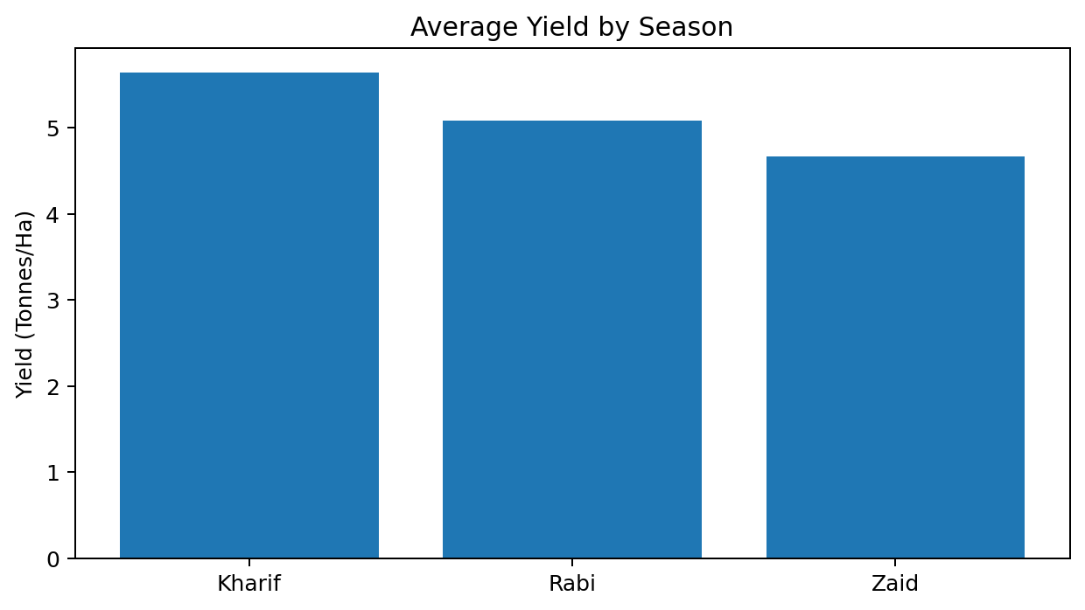
RESULTS – SEASONAL YIELD
Kharif recorded the highest average yield: 5.64 tonnes/ha.
Rabi average yield: 5.08 tonnes/ha.
Zaid average yield: 4.67 tonnes/ha.
The chart shows clear differences in sample averages across seasons.

Slide 7
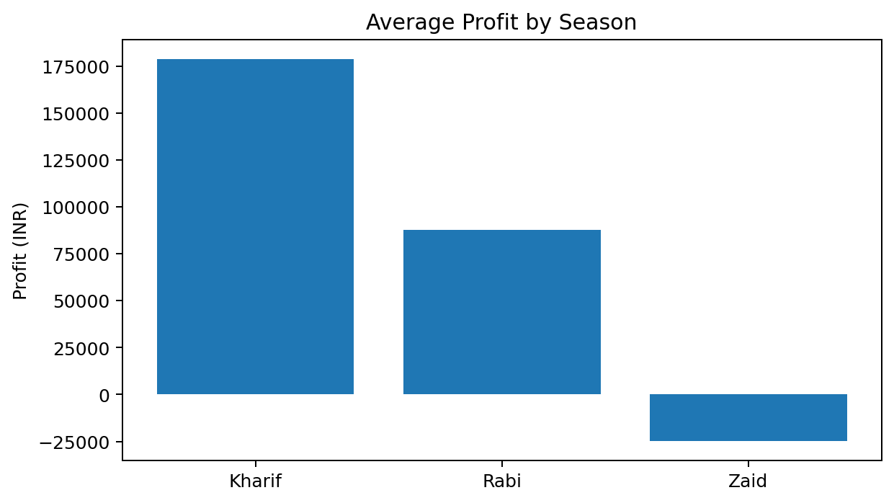
RESULTS – ECONOMIC PERFORMANCE
[Add screen shots of your code ]
Kharif average profit: ₹178,914.65
Rabi average profit: ₹87,689.47
Zaid average profit: ₹-24,804.82
Kharif had the highest average profit, while Zaid had a negative average profit in this dataset.

Slide 8
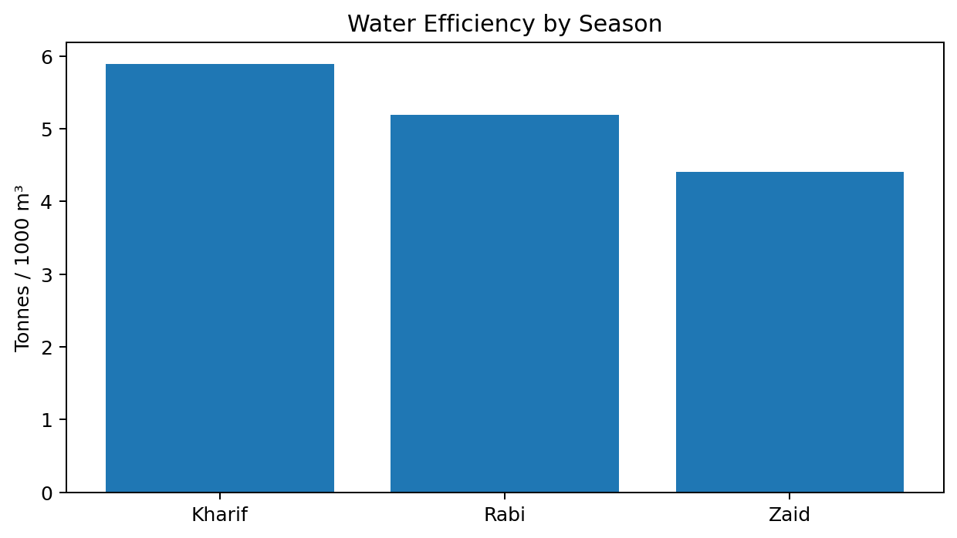
RESULTS – WATER & RISK
[Add screen shots of your code ]
Highest water efficiency: Kharif (5.89 tonnes/1000 m³).
Lowest disease/pest risk: Zaid (38.22%).
Kharif used 6102.20 m³ of water on average; Zaid used 6419.89 m³.

Slide 9
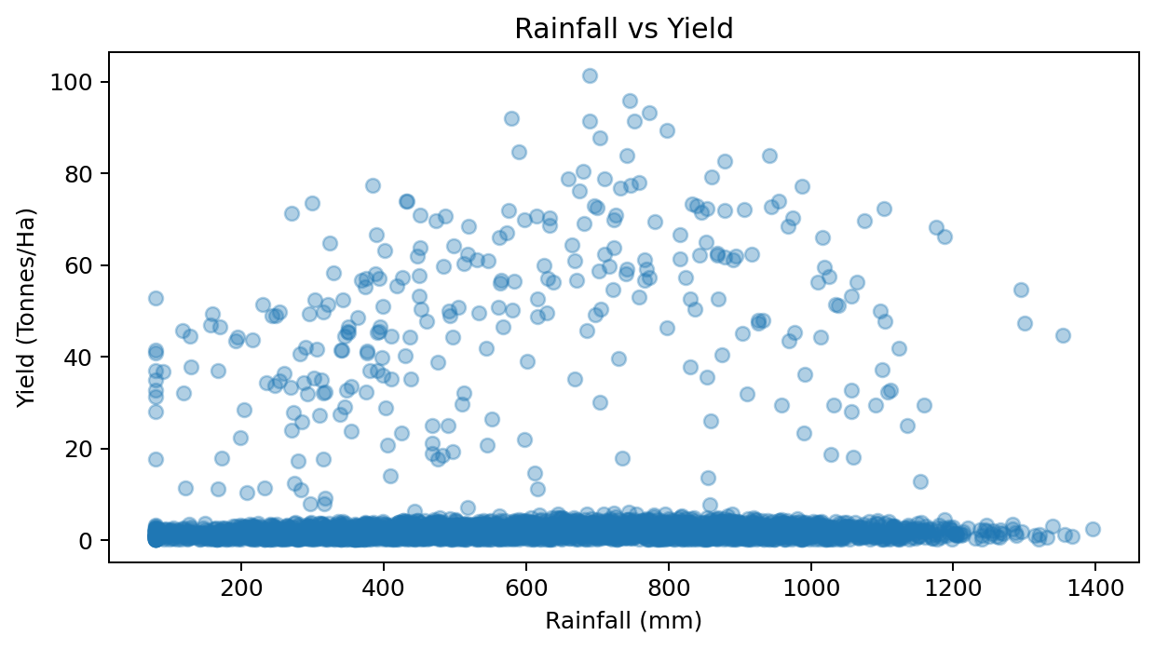
RESULTS – ENVIRONMENTAL RELATIONSHIP
[Add screen shots of your code ]
Rainfall–yield correlation: 0.031.
This indicates a very weak linear association in the full dataset.
Other environmental and resource variables were also examined using correlation analysis.

Slide 10
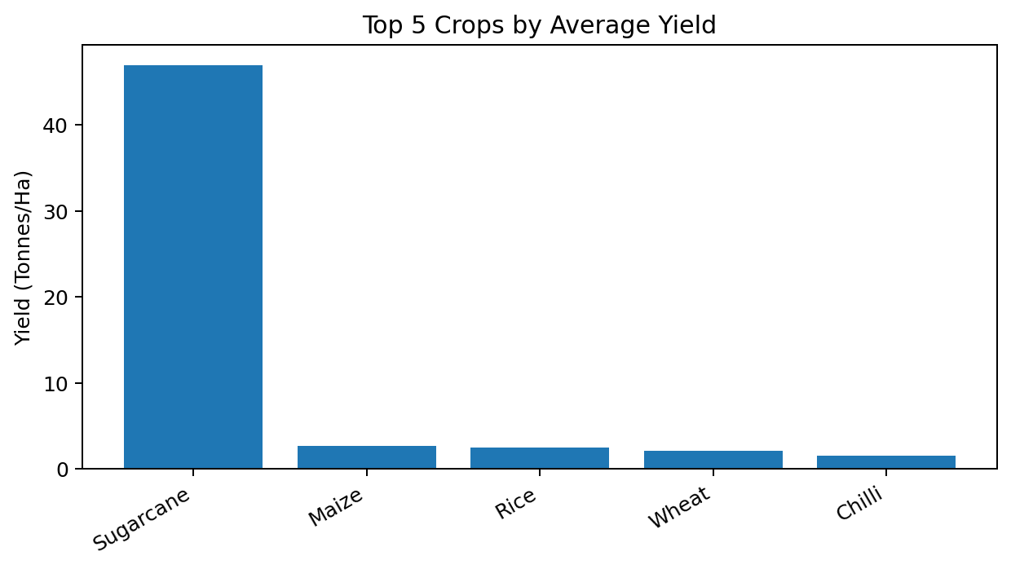
RESULTS – STATISTICAL ANALYSIS
[Add screen shots of your code ]
One-way ANOVA for yield across seasons:
F-statistic = 1.458
P-value = 0.2328
At α = 0.05, the p-value is greater than 0.05. Therefore, the observed seasonal differences in average yield are not statistically significant at the 5% level.
Top average-yield crop in the dataset: Sugarcane (46.94 tonnes/ha).

Slide 11
Future Scope
Develop predictive models for crop yield and profitability.
Add time-series/weather forecasts for future seasonal planning.
Build an interactive dashboard using Streamlit or Power BI.
Include more years of historical agricultural data.
Study crop-specific and region-specific seasonal patterns in greater depth.
Investigate causal factors and test recommendations with field data.

Slide 12
GitHub Link
GitHub Repository:
https://github.com/________________________
(Replace with your own repository link before submission.)
Project notebook and dataset analysis can be uploaded to the student's GitHub repository.

Slide 13
VOIS Course Completion Certificate
Course Name – Data Visualization

Slide 14
Thank You
.
.
.

